Slide 1
Waterloo Primary School Welcome To Reception 2023-2024

Slide 2
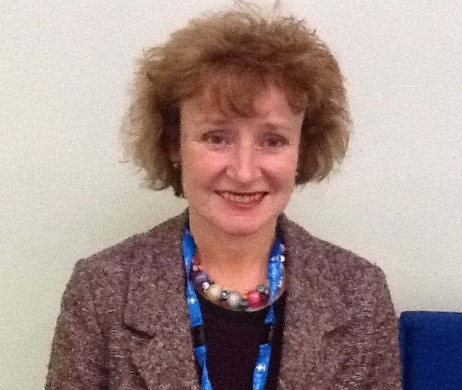
Head Teacher’s Welcome
Mrs Baldwin

Slide 3
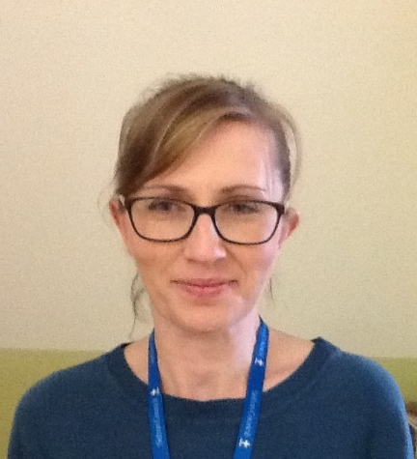
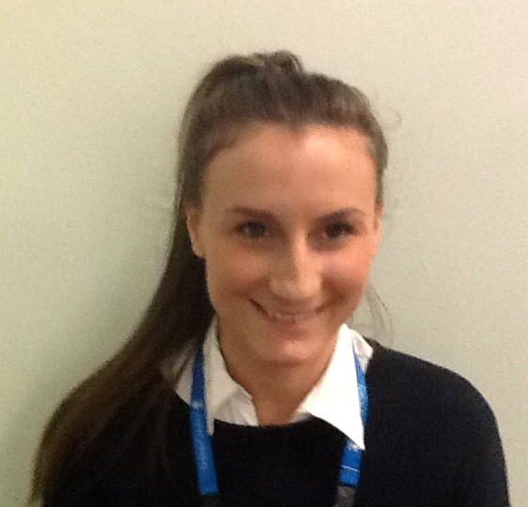
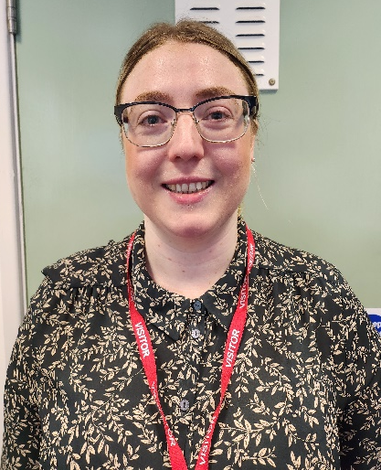
Meet the Team
Mr Riley
Mrs Franklin
Mrs McWilliam
Mrs Farrall
Miss Williams
Mrs Harper

Slide 4
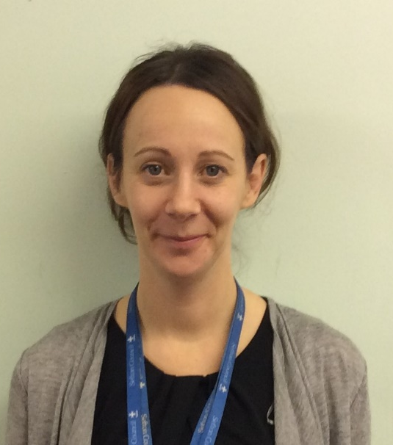
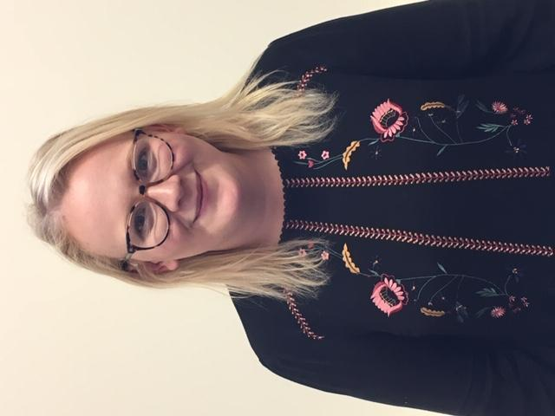
Other Key Staff
Mrs Maciver –Deputy Head
Mrs Jones –Asst. Head & SENDCo
Mrs Wilson –Asst. Head
Miss Wainwright– Nursery Teacher

Slide 5
Learning & Development There are 7 different areas of learning which are further split into 17 early learning goals
Prime Areas
These areas are particularly important for building a foundation for igniting children’s curiosity and enthusiasm for learning, forming relationships and thriving.
• Communication and Language
• Physical Development
• Personal, Social and Emotional Development.
Specific Areas
We also support children in four specific areas, through which the three prime areas are strengthened and applied
• Literacy
• Mathematics
• Understanding the World
• Expressive Arts and Design

Slide 6
Phonics & Reading
We will start teaching phonics within the first few weeks of the autumn term and we use the Phonics Bug scheme. This scheme also allows you to have online access to games and books at home and you will receive login details shortly after starting school.
We read daily within our phonics lesson and your child will bring a reading book home. They will also bring home a choice book, which is a book for you to share with them to further inspire their love of reading.
We expect the children to read at least 5 times per week at home and ask that a reading record is filled in by the parent or carer. We place great emphasis on reading at Waterloo Primary as a means to learning but also as a pleasurable activity.
We would encourage you to join the local library if you haven’t already!

Slide 7
Handwriting
Handwriting is also taught daily during phonics, following the schools letter formation policy. A copy of the letter formation can be found on the website. Reception children learn to write in print, and move onto cursive once they are able to form letters fluently.
You can help support your child’s handwriting by increasing their fine motor skills. This can be strengthened by playing with playdough, fine motor toys and lots of colouring and mark making!
abcdefghijklmnopqrstuvwxyz

Slide 8
Preparing Your Child for School
Read books & share stories.
Play with them often.
Talk with them as much as you can.
Support them to recognise their written name.
Practise writing their name.
Count objects around the home, or when you’re out and about.
Encourage your child to get dressed and undressed themselves.
Teach them to put on, take off and zip up their coats independently.
Support your child to be independent when going to the bathroom.
Practise eating using a knife and fork.

Slide 9
Uniform
Badged uniform is available from Monkhouse.
Plain uniform is acceptable and is available from many supermarkets
School uniform is a red cardigan or jumper, white polo shirt and grey skirt, trousers or shorts.
Black shoes with Velcro fastenings – please refrain from giving your child laced shoes.
Long hair must be tied back and any bows must be small, black, white or red.
Please ensure all uniform is named, including shoes.
Their uniform will get dirty, this is proof they are learning!
If you prefer then your child can wear PE kit each day.

Slide 10
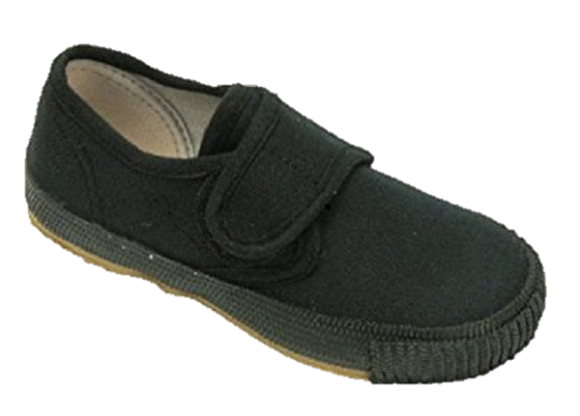
PE
PE takes place once a week and your child is to come to school in the correct kit on PE Day.
PE kit is a red polo top, blue shorts and black pumps.
Earrings must be removed before school on PE days.
Try to encourage your child to dress and undress independently.

Slide 11
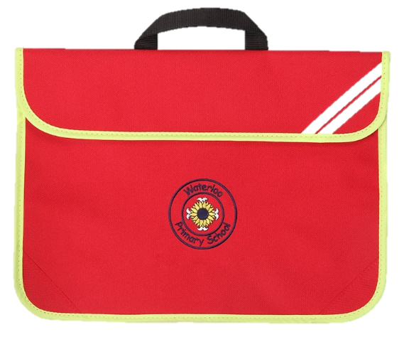
Book Bags
Please provide a red book bag for your child – they will need it to carry their reading book and also their pictures and paintings.
Look through your child’s bag daily and celebrate what they have done in school.
Occasionally we will send letters home and these will also be in your child’s bag, although generally most communications are made using ParentApps.

Slide 12
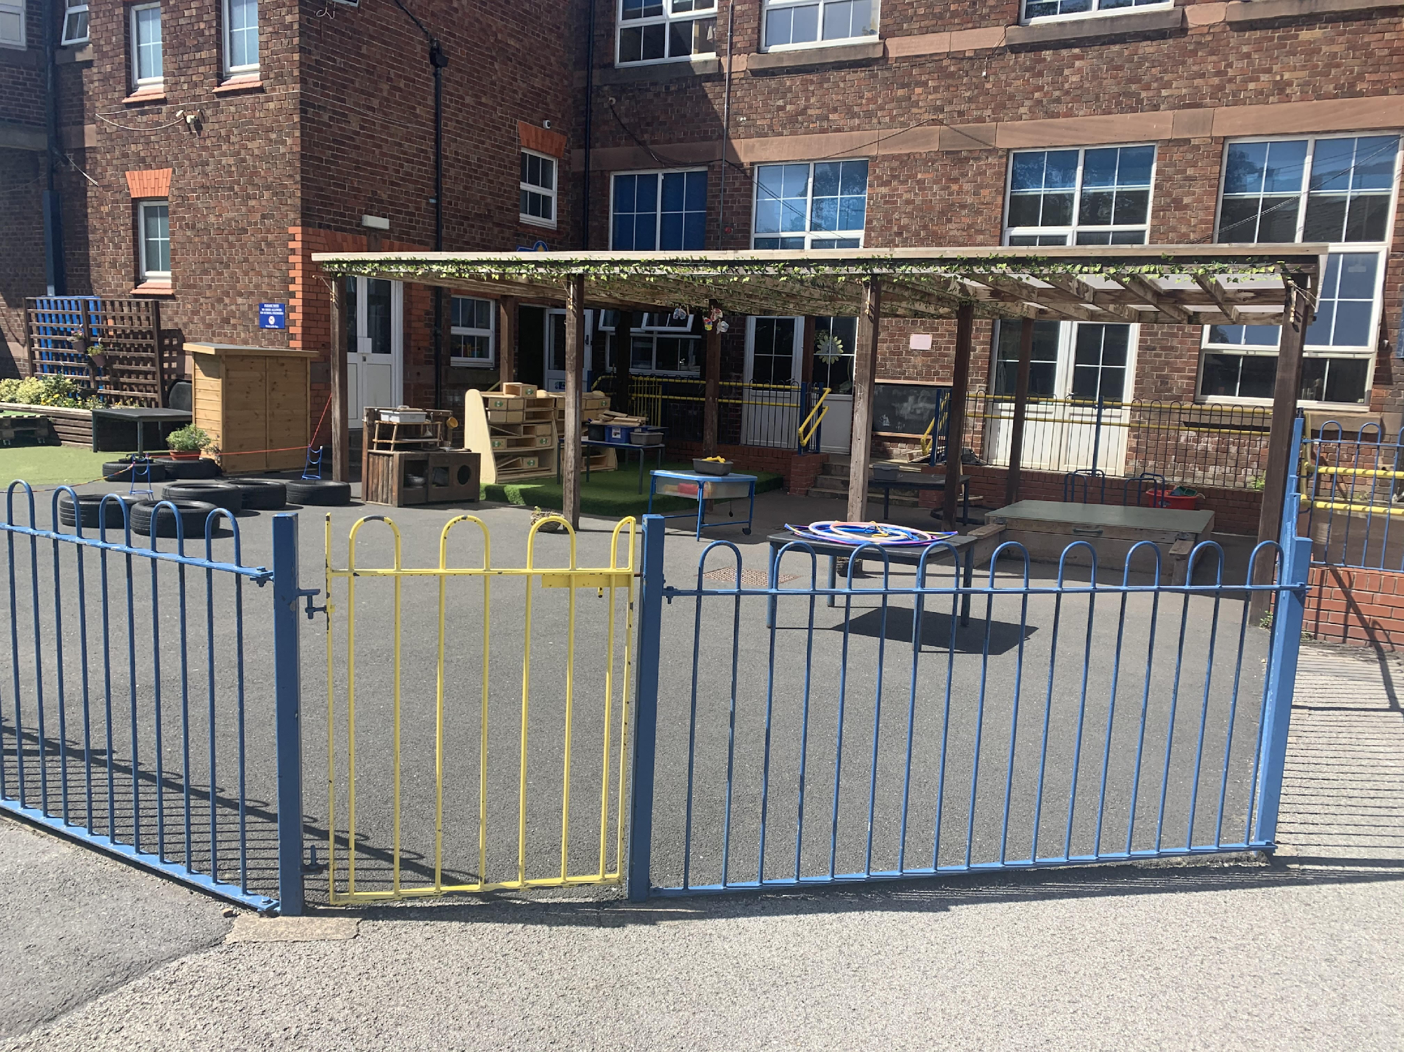
First Day of School
Children are to be dropped off at the yellow Reception gate in the playground.
They are collected from the same gate at home time.

Slide 13
Snack & Lunch
We have snack time each morning. All children are provided with fruit and toast can be purchased for 20p per day. Children have access to their water bottles throughout the day, and milk during snack time.
All Reception children are entitled to a free school lunch however, if you prefer you are welcome to provide a healthy packed lunch for them.

Slide 14
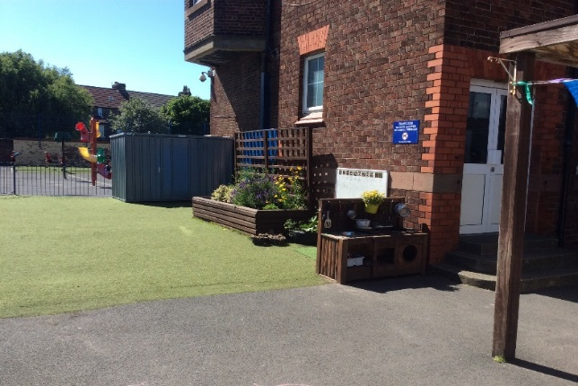
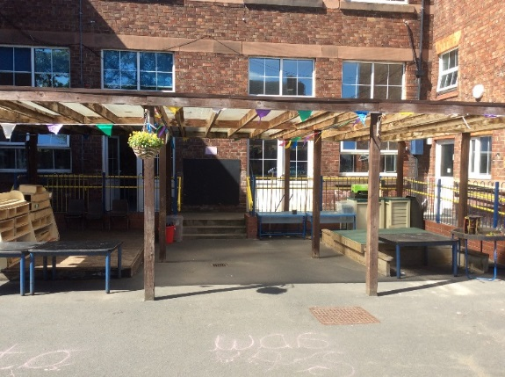
Outdoor Learning
Outdoor learning is a fundamental part of Reception therefore, we go outside in all weathers. It is important your child is dressed appropriately for school.
For example;
Warm, washable coats and warm hats in winter.
Sunhats and sun cream in summer.

Slide 15
Transition Days 29th & 30th June
Tonight, you will receive information regarding transition days.
These are short sessions where your child can come into school to familiarise themselves with the environment, staff members and the other children who will be in their classes.
Please ensure you have contacted the school office to confirm your attendance.

Slide 16
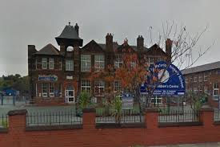
Thank you
If you have any further questions please do not hesitate to contact school and a member of the Reception Team will be in touch.
Phone:
0151 928 4274
Email admin@waterlooprimaryschool.co.uk

